Slide 1
Year 11 ASSEMBLY
MARCH 2020
The final chapter

Slide 2
Mr rodriguez

Slide 3
ENDEAVOUR
Mr PARSONS

Slide 4
Huge Thanks to
Mrs Heath and Mrs Gee
Ms Froud and Mr Morris
Grace Bartlett Alex Martin
We will miss you all

Slide 5
Discovery House
A message from
Mrs Rowe

Slide 6
Year 11, I am so sorry I can not be with you today to say goodbye and wish you well. You have been a wonderful year group and credit to yourselves.
Firstly, I would like you all to thank your Group Tutors who have been there through thick and thin to give you support and guidance - please give them all a round of applause as they deserve it (especially Discovery House tutors Mrs Garrick, Mr Hastings and Mr Anderson who are the best!).
You also need to give a roaring applause to Mrs McDonald - she has been there to patch you up when you're injured, a shoulder to cry on when you are sad and has been a fabulous Assistant Head of Discovery House, thank you Mrs McDonald!
My last thanks goes of course to my Year 11 mentors, House captains and vice captains, you are all just brilliant and have done so much over the past year I really can’t thank you enough.
Although this is certainly not the goodbye and good luck we all expected, I hope you all have fond memories of your time with us and we will see soon when you collect your GCSE certificates.
Finally, remember to give Miss Gyngell a big thank you for arranging this special final assembly at such short notice.
Take care, Mrs Rowe x

Slide 7
Pioneer
Mr fitzpatrick

Slide 8
Big thank you to Mrs Corbett for all the support she provided to you throughout your time here.
And to your tutors who helped you transition from innocent little kids to lairy teenagers: Mr Leonard and Miss Madeddu.
What a journey it’s been!It’s been a long and winding road but you got there in the end. Well done and I hope you all have happy and successful futures.
Thanks to our House Captains Molly and Henry and our Vice Captains Georgia and Will who have helped to develop the role and did great work for the House.

Slide 9
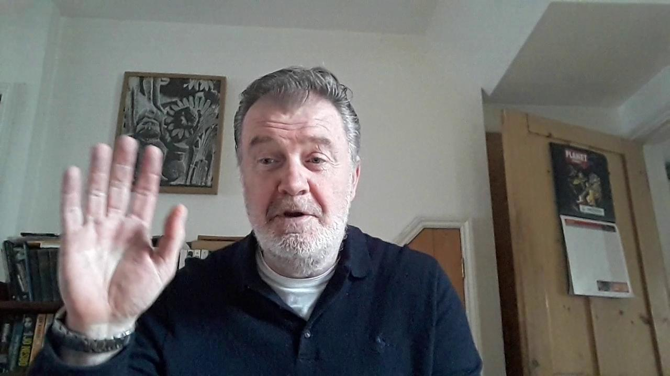
Click to open video
Notes:
See the video on the Leavers’ Website: https://youtu.be/zhjhbpahsPo

Slide 10
VOYAGER
Mr PARRY
Thank you!
Mrs Newnham
Mrs MacTaggart and Mrs Da Silva
Lottie, Daisy, Katie + Millie

Slide 11
Put effort into whatever you decide to do
Be honest and own your mistakes
Don’t worry if you haven’t got a long term goal yet!

Slide 12
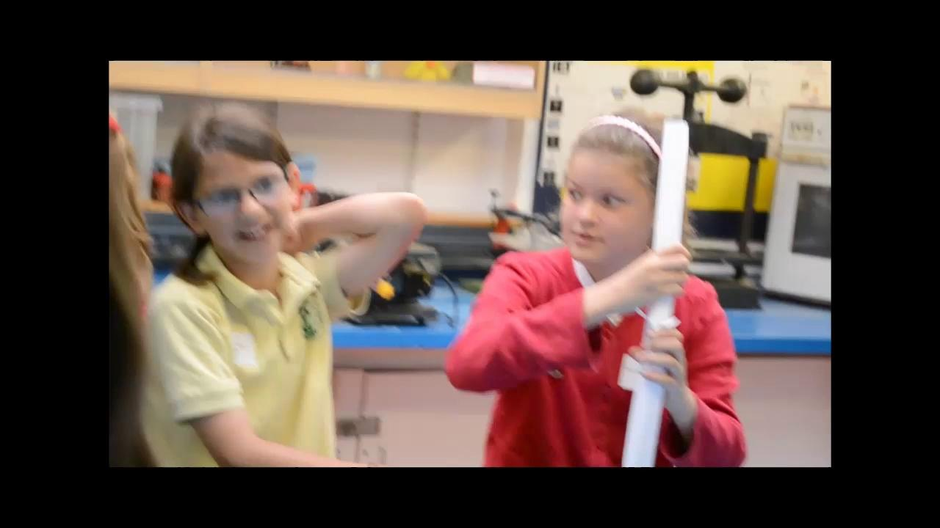
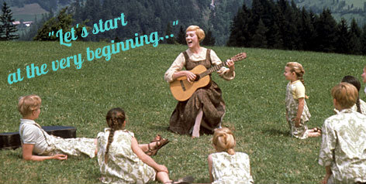

Slide 13
Year 11 tutor team

Slide 14
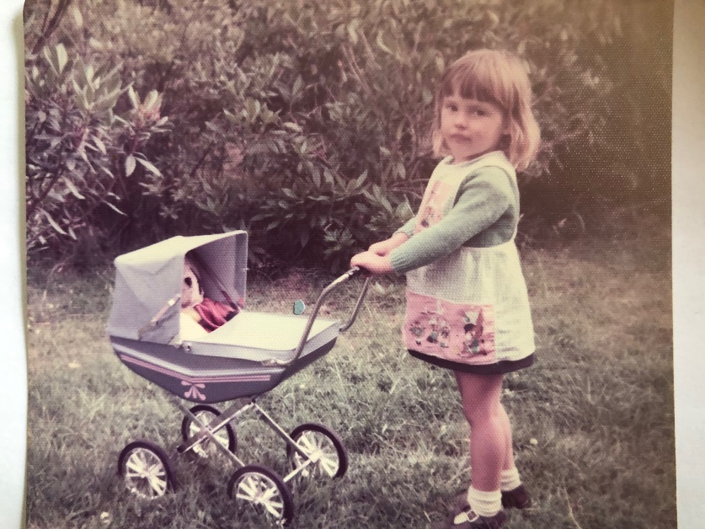
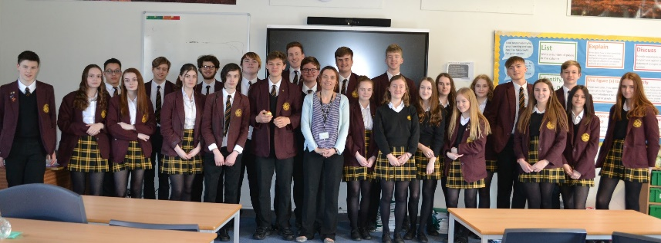
MRS GARRICK 11 KRG
Since the beginning of September I have been dreading this day but never imagined it would happen so soon and so suddenly. There have been many tears this week. I had a lot of things planned and maybe they will still happen. I’m so proud of the young people you have become, and not just in the way you approach school life but also as real people who care for others. I am always telling everyone how I have the nicest tutor group in the entire school and how lucky I have been to have had you all for (almost) 5 years. You make me laugh every day and I have great memories of all of you. Balls, superman and prams spring to mind (hence the choice of photo - notice how I am holding onto the pram tightly!). You really are a lot of fun to be in a room with. Please keep in touch Love you all Mrs Garrick XX

Slide 15
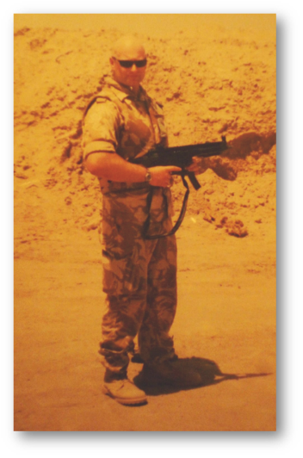
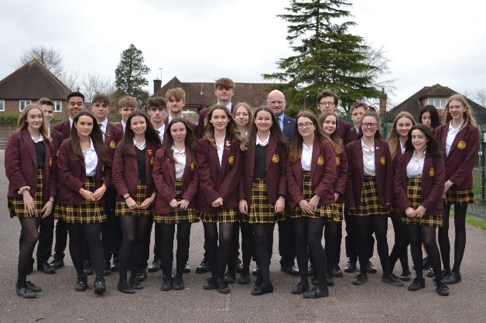
Mr HASTINGS
Who would have thought … those little Year 8 faces looking up at me with the universal expression: “Who is this big, bald, scary bloke, where is the lovely Mrs Edwards ???!!” … are now Year 11 and off to embrace amazing futures! It has been my honour and privilege to be your tutor! We’ve had some laughs; we’ve had some tears; we’ve had some cake!
Be all you can be; dig deep and if you give 110% it’s amazing what you can achieve. You are great ambassadors for your generation! I will miss you,
My new tutor group will have big shoes to fill.
Stay in touch, I want to hear how things go with you … I mean it! Look after one another, all those you love and yourselves. Class dismissed (... when Ellie is quiet)

Slide 16
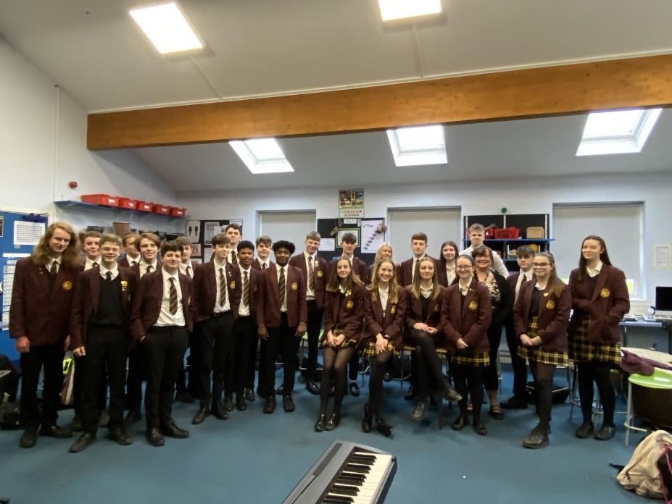
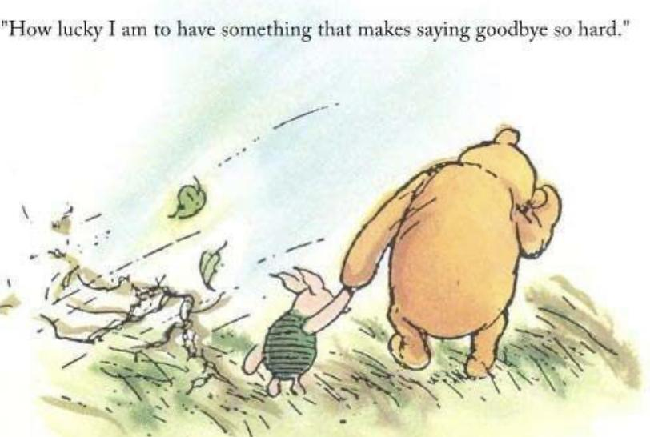
MRS MACTAGGART
11VCM Thank you for the last 5 years.
I have loved having you all in my
Tutor group. I cannot believe it's
been 5 years since I met you as wee
Year 7’s. You have grown into such
fine young people with amazing things
ahead of you and I am so very proud of
all of you! Please stay in touch! Two
more words to say… Patrick and Henry!!

Slide 17
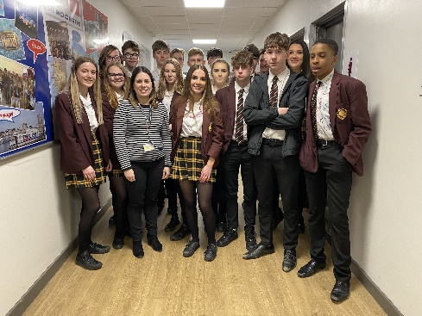
MRS DA SILVA
Dear Y11VCDS,
It has been a long journey and I wanted to say thank you for all the hard work you have put into your lessons and in tutor time. I have many lovely memories that I will always remember. I still remember the first time I saw you all in the assembly hall and look at you now - so grown up! I wish you all the very best for your future and I’m sure you will do amazing things. I will miss you all xx
Stay safe.
Lots of love,
Mrs Da Silva

Slide 18
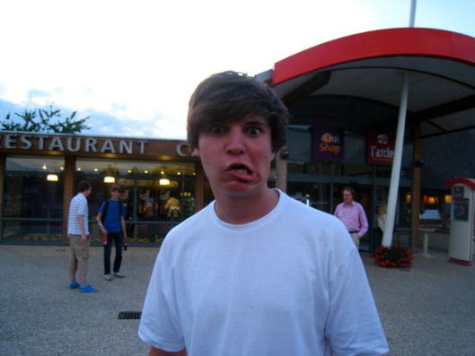
MR LEONARD
As I look back to 5 years ago, when you came to visit the school for your Year 6 induction day, I couldn’t have imagined what you would all be like now. You have all surpassed every expectation I had of what kind of young adults you would become and I am so proud to call you my tutor group, 11PJL!! You are credits to yourselves and I have every faith that you will continue to grow into fantastic young adults.
I will really miss everyone of you and I wish you all the luck in your futures! Stay safe and healthy!
Me at 16! >>>

Slide 19
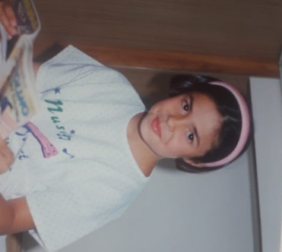
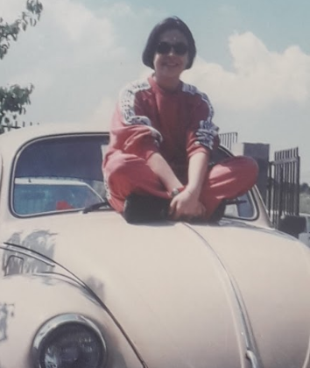
MS MADEDDU
Hi 11PSM, I’m sorry I can't be there today to say goodbye... I will miss each of you!
For the last five years I have seen you smiling, worrying, laughing, sharing, arguing, crying but, above all, supporting each other, keep doing it!
Thank you for everything you have taught me ... and for counting down from 10 to 0 in Italian with me!! :)
I wish you all the luck in your future!
Arrivederci!

Slide 20
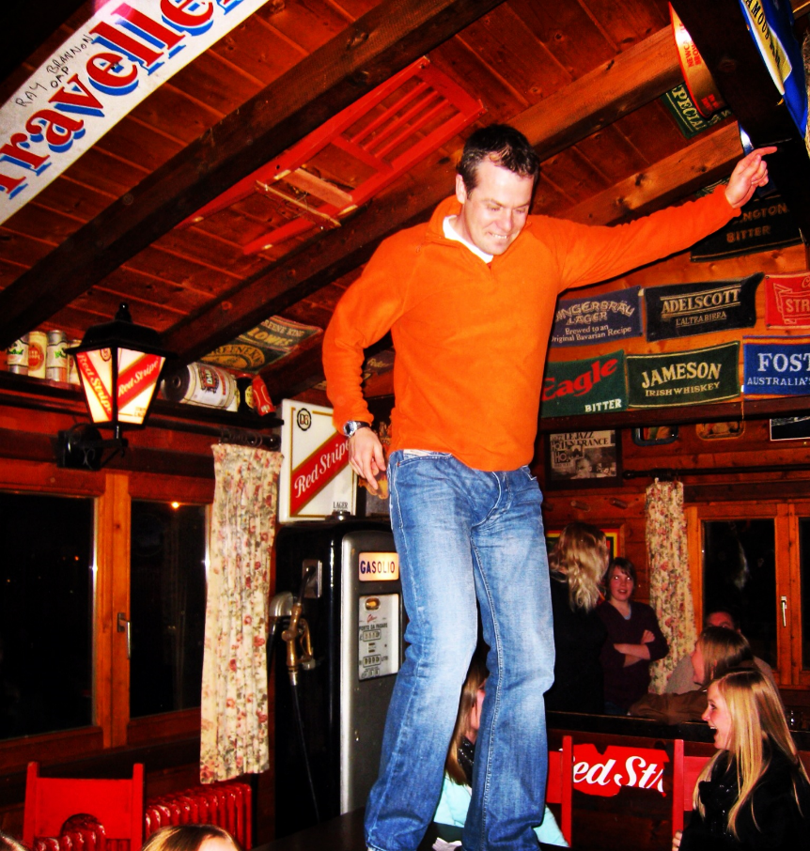
Mr MORRIS
Just wanted to wish you all the very best moving forward into your next adventure. It’s been great seeing you all develop into a group of young people ready to take on the world.
Some lively debates along the way and sorry for all the long stories!
Ta-ra

Slide 21
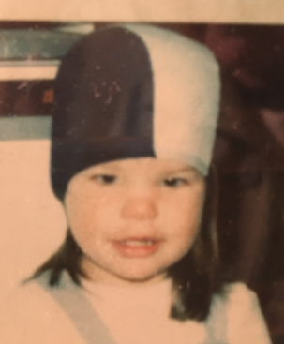
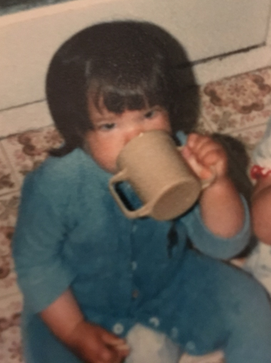
MISS FROUD
You lot are amazing! I Will miss each of you very much but know that you will go on to do wonderful and extraordinary things in the future. You have made me laugh every single day. I am incredibly proud of you.

Slide 22
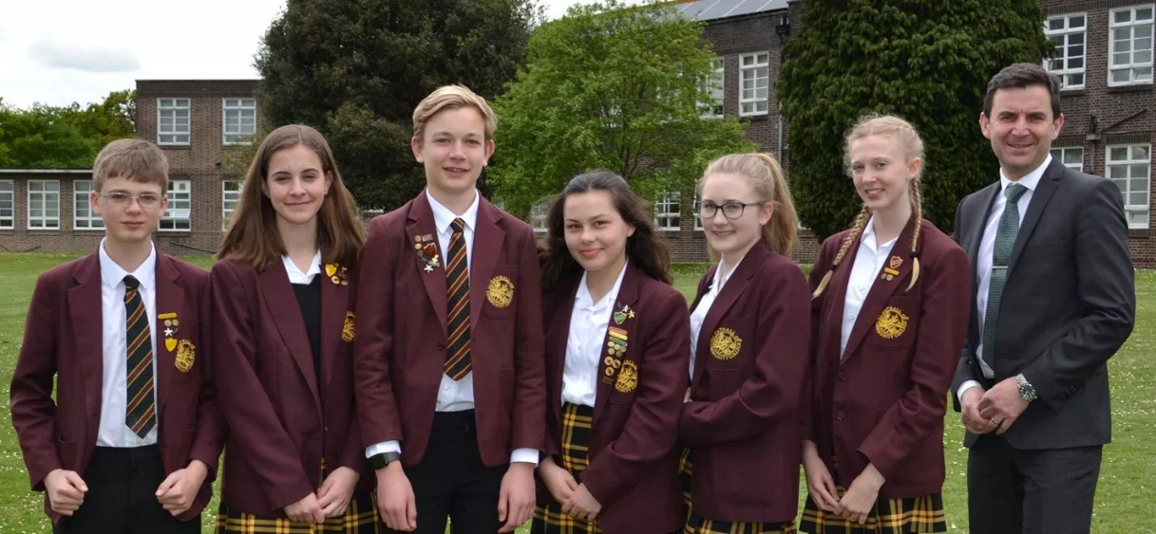
PERFECT PREFECTS!
Thank you to all faculty & duty prefects

Slide 23
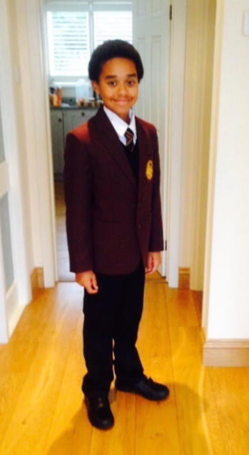

Slide 24
Goodbye & GOOD LUCK FROM US ALL...

Slide 25
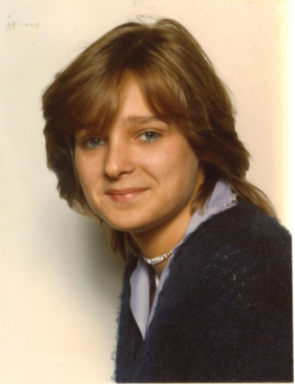
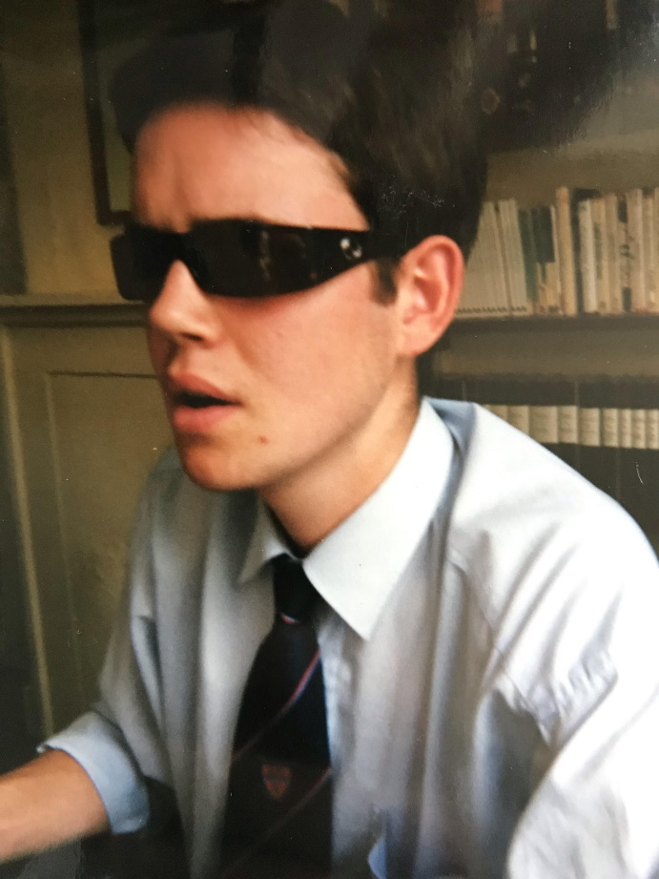
VOYAGER
Mrs Newnham
Mr Parry

Slide 26
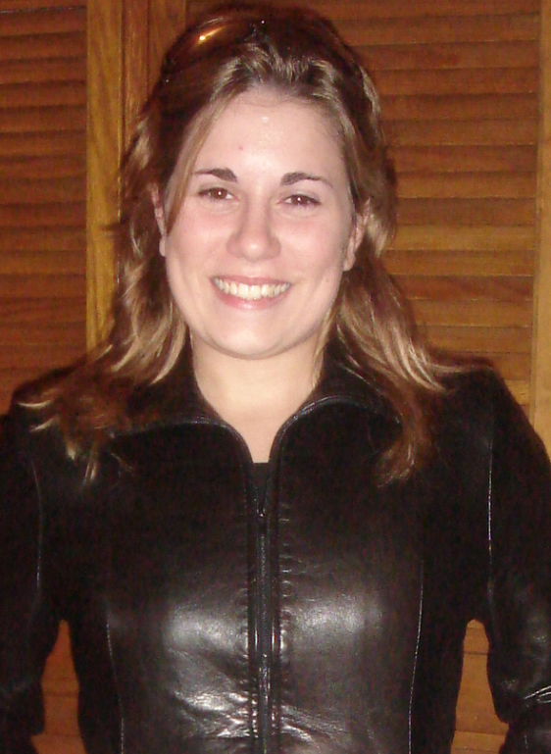
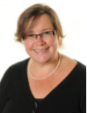
Mrs MacTaggart
Mrs Da Silva

Slide 27
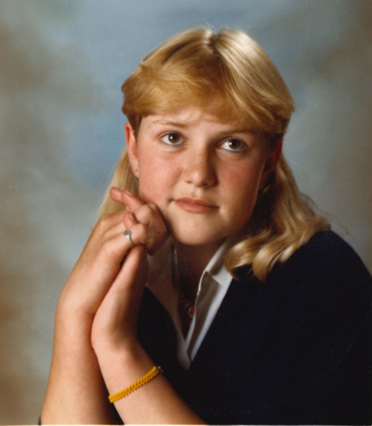
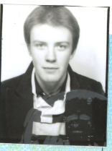
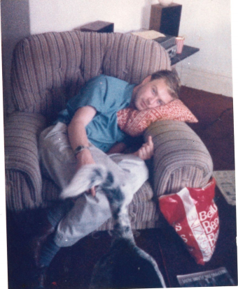
PIONEER
Mr Fitzpatrick
Mrs Corbett

Slide 28
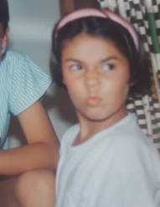
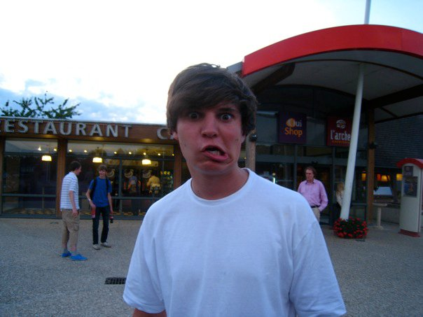
Miss Madeddu
Mr Leonard

Slide 29
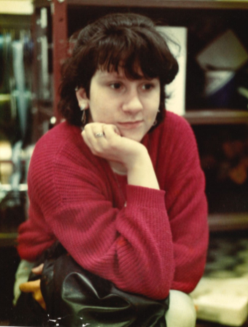
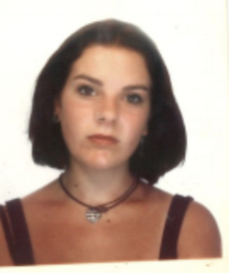
DISCOVERY
Mrs Rowe
Mrs McDonald

Slide 30
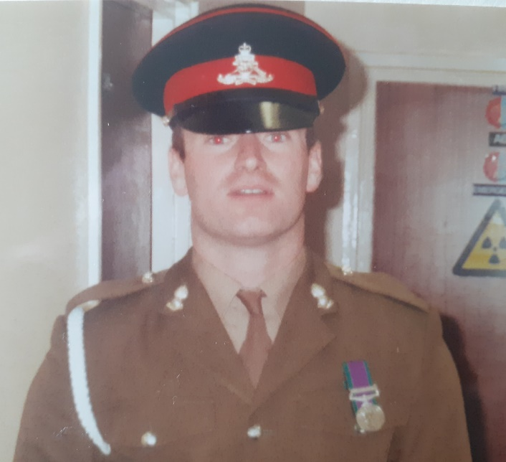
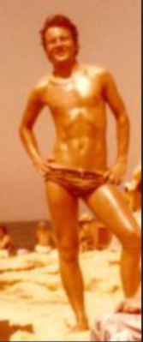
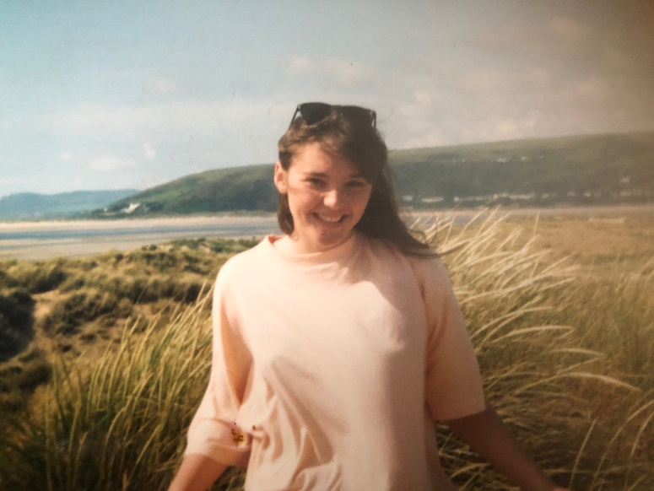
Mrs Garrick
(I was 16 once)
Mr Hastings aged 20(Sorry … I was never a teenager)
Mr Anderson (really it is!)

Slide 31
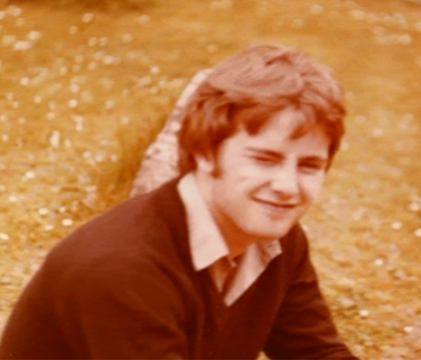
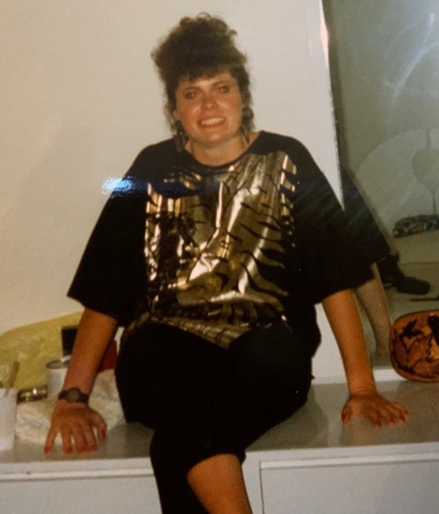
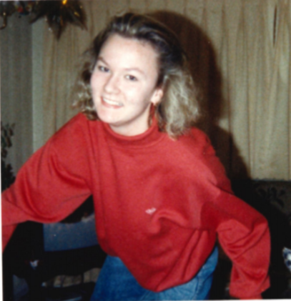
ENDEAVOUR
Mr Parsons
Mrs Heath
Mrs Gee

Slide 32
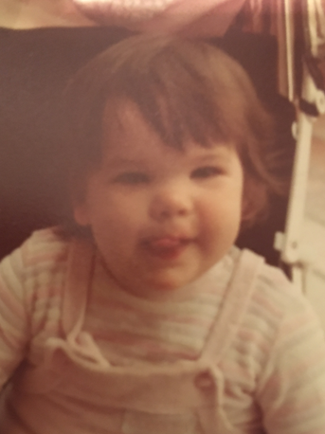
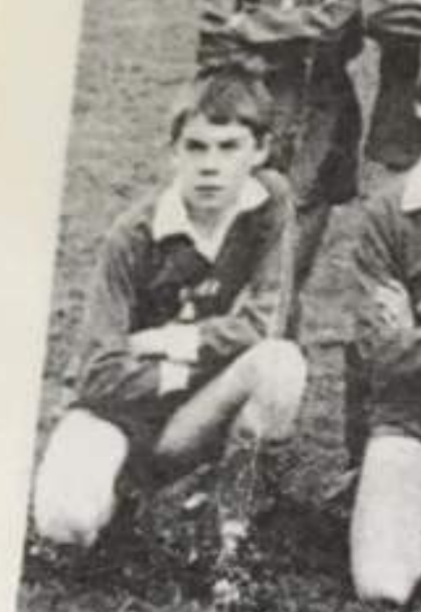
Miss Froud
Mr Morris

Slide 33
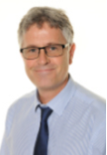
Mr Parsons

Slide 34
Photos Video
In the real assembly, the shortened, unfinished photos video was played to students.
You can find the short video here: https://youtu.be/eJvJbOf-pVY
The longer video is available from the Oathall Leavers website: https://oathall-leavers.web.app/

